Slide 1
Introduction to FHIR May 6, 2017 HL7 FHIR Connectathon 15
Richard Ettema
FHIR® Certified Implementer
Lead Consultant, AEGIS.net, Inc.
richard.ettema@aegis.net

Slide 2
This presentation
Can be downloaded at:
http://gforge.hl7.org/svn/fhir/trunk/connectathons/MadridMay2017/Connectathon15/FHIR%20Overview.pptx
(use “anonymous” and email address)
Is licensed for use under the Creative Commons, specifically:
Creative Commons Attribution 3.0 Unported License
(Do with it as you wish, so long as you give credit)

Slide 3
The acronym
F – Fast (to design & to implement)
Relative – No technology can make integration as fast as we’d like
H – Healthcare
That’s why we’re here
I – Interoperable
Ditto
R – Resources
Building blocks – more on these next
Notes:
9:25

Slide 4

Resources
Defined Structured Data
The logical, common contents of the resource
Mapped to formal definitions/RIM & other formats
Syntax – XML, JSON and RDF (JSON-LD)
Extensions
Local requirements, but everyone can use
Published and managed
Narrative
Human readable

Slide 5
<Patient xmlns="http://hl7.org/fhir">
<id value="example"/>
<meta>
<lastUpdated value="2017-01-14T09:14:33Z"/>
</meta>
<text>
<status value="generated"/>
<div xmlns="http://www.w3.org/1999/xhtml">
<p>Henry Levin the 7th</p>
</div>
</text>
<extension url="http://hl7.org/fhir/StructureDefinition/us-core-birthsex">
<valueCode value="M"/>
</extension>
<identifier>
<use value="usual"/>
<system value="urn:oid:1.2.36.146.595.217.0.1"/>
<value value="12345"/>
</identifier>
<active value="true"/>
<name>
<use value="official"/>
<family value="Levin"/>
<given value="Henry"/>
<suffix value="the 7th"/>
</name>
<gender value="male"/>
<birthDate value="1974-12-25"/>
<managingOrganization>
<reference value="Organization/example"/>
</managingOrganization>
</Patient>
FHIR Id & Metadata
Human Readable Summary
Extension with reference to its definition
Standard Data Content:
Patient Identity
Name
Gender
Date of Birth
Provider

Slide 6
{
"resourceType": "Patient",
"id": "example",
"meta": {
"versionId": "1",
"lastUpdated": "2017-01-03T16:05:00.792Z"
},
"text": {
"status": "generated",
"div": "<div xmlns=\"http://www.w3.org/1999/xhtml\"><p>Henry Levin the 7th</p></div>"
},
"extension": [
{
"url": "http://hl7.org/fhir/StructureDefinition/us-core-birthsex",
"valueCode": "M"
}
],
"identifier": [
{
"use": "usual",
"system": "urn:oid:1.2.36.146.595.217.0.1",
"value": "12345"
}
],
"active": true,
"name": [
{
"use": "official",
"family": "Levin",
"given": [ "Henry“ ],
"suffix": [ "the 7th“ ]
}
],
"gender": "male",
"birthDate": "1974-12-25",
"managingOrganization": {
"reference": "Organization/example"
}
}
FHIR Id & Metadata
Human Readable Summary
Extension with reference to its definition
Standard Data Content:
Patient Identity
Name
Gender
Date of Birth
Provider

Slide 7
It’s all about the resources . . .
Building blocks…
Location
Related
Person
Patient
Diagnostic
Report
Practitioner

Slide 8
What is a Resource?
Examples
Non-examples
Administrative
Patient, Practitioner, Organization, Location, Coverage, Invoice
Clinical Concepts
Allergy, Condition, Family History, Care Plan
Infrastructure
Document, Message, Profile, Conformance*
Gender
Too small
Electronic Health Record
Too big
Blood Pressure
Too specific
Intervention
Too broad

Slide 9
Capability*
There’s a resource for documenting the capabilities of a FHIR client and server.
Can be used for:
Stating how a specific system instance behaves
Defining how a software system is capable of behaving (including configuration options)
Identifying a desired set of behavior(s)
To declare themselves “FHIR Conformant”, a system must publish a CapabilityStatement.

Slide 10

Human Readable
CDA taught HL7 a very important lesson
Even if the computers don’t understand 99% of what you’re sending, that’s ok if they can properly render it to a human clinician
This doesn’t just hold for documents
Important for messages, services, etc.
Resources SHOULD always contain narrative to support human-consumption as a fallback.
Notes:
Even when you think your target will understand all the encoded data, reality is data often gets shared beyond the originally intended context
Allow for exceptions for things like automated device readings, etc.

Slide 11
Paradigms
FHIR supports 4 interoperability paradigms
REST
Documents
Messages
Services

Slide 12
REST
Simple, out-of-the-box interoperability
Leverage HTTP: GET, POST, etc.
Pre-defined operations
Create, Read, Update, Delete
Also: Patch, History, Read Version, Search, Validate, Conformance, Batch & Transaction
Works best where control resides on client side and trust relationship exists
REST
Notes:
URLs, parameters, etc. all defined
Choice of what operations to support
Behavior documented in conformance profile - mandatory

Slide 13
Documents
Similar to CDA
Collection of resources bound together
Root is a “Composition” resource
Just like CDA header
Sent as a Bundle (FHIR Resource)
One context
Can be signed, authenticated, etc.
Documents

Slide 14
Messages
Similar to v2 and v3 messaging
Also a collection of resources as a Bundle (FHIR Resource)
Allows request/response behavior for both request and response payloads
Event-driven
e.g. Send lab order, get back result
Can be asynchronous
Messages

Slide 15
Service Oriented Architecture (SOA)
Combination of previous paradigms
(based on SOA principles)
Ultra complex workflows
Ultra simple workflows
Individual resources or collections (in Bundle, contained resources or other formats)
Use HTTP or use something else
Only constraint is that you’re passing around FHIR resources in some way, shape or manner
Services

Slide 16

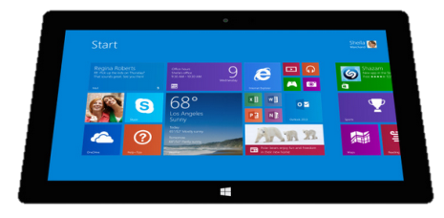
Regardless of paradigm the content is the same
Receive a lab result in a message…
FHIR
Repository
FHIR Message
FHIR Document
Lab System
REST
National
Exchange
…Package it in a discharge summary document

Slide 17

FHIR & other SDOs
IHE
Using FHIR for MHD (mobile XDS) and PDQm (mobile Patient Query)
http://www.ihe.net/uploadedFiles/Documents/ITI/IHE_ITI_Suppl_MHD.pdf
http://www.ihe.net/uploadedFiles/Documents/ITI/IHE_ITI_Suppl_PDQm.pdf
ONC
Structured Data Capture Initiative to facilitate the collection of supplemental EHR-derived data
http://wiki.siframework.org/Structured+Data+Capture+Initiative
Because FHIR is free and because of how it’s structured, use by other SDOs is expected

Slide 18
Recap: What does FHIR provide?
Resources (building blocks)
Extensions (part of the spec)
Methodology
Bundles, Profiles, Conformance
Syntax - XML, JSON and RDF (JSON-LD)
Human readability
Support for multiple Paradigms
REST, Messaging, Documents, Services

Slide 19
FHIR Timeline (planned)
First Draft
DSTU
1.0
DSTU
2.0
STU
3.0
~ 1st
Norm.
. . .
2011
2012
2013
2014
2015
2016
2017
2018
2019
2020

Slide 20
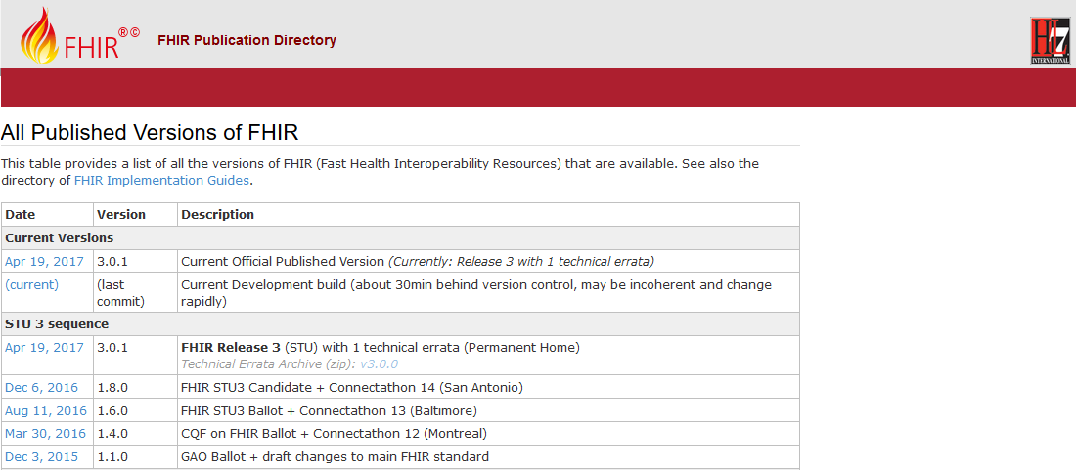
FHIR Specification
Directory to all FHIR versions: http://hl7.org/fhir/directory.html

Slide 21
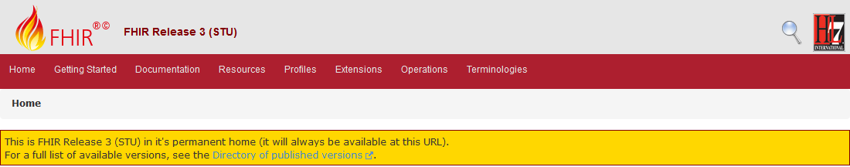
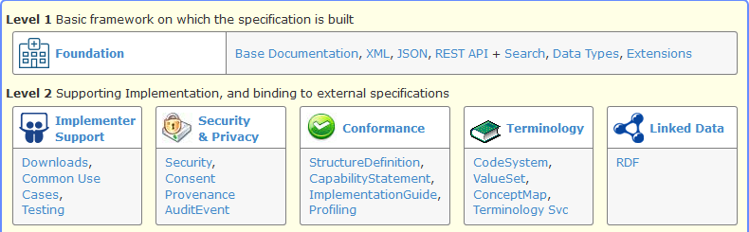
FHIR Specification
Useful links: Resource, REST API, Testing

Slide 22

Discussion (Q & A)

